Slide 1
Improve the LACE Score Value in Predicting 30-day Readmission
Sean Babcock
David Ball

Slide 2
What is LACE?
LACE is an index that identifies patients that are at risk for readmission or death within thirty days of discharge.
“L” stands for the length of stay of the index admission.
“A” stands for the acuity of the admission. Specifically, if the patient is admitted through the Emergency Department vs. an elective admission.
“C” stands for co-morbidities, incorporating the Charlson Co-Morbidity Index.
“E” stands for the number of Emergency Department visits within the last 6 months.

Slide 3
Goals of this project
Better use the currently defined overall LACE score, or combinations of the 4 individual LACE components, to predict 30-day readmission risk with a predictive model.
Use previously collected data to calculate LACE components and overall LACE score to build the predictive model.
Identify those at potential risk of a 30-day readmission (after index admission) and apply preemptive measures to reduce the chances of a 30-day readmission.

Slide 4
Why predict 30-day readmissions?
1. Financial considerations:
Healthcare provider
Payer
Patient
Government (Medicare/Medicaid)
2. Quality of care and patient satisfaction

Slide 5
Government requirements
Most U.S. hospitals will get less money from Medicare in fiscal 2016 because too many patients return within 30 days of discharge.
Only 799 out of more than 3,400 hospitals subject to the Hospital Readmissions Reduction Program performed well enough on the CMS' 30-day readmission program to face no penalty.
Thirty-eight hospitals will be subject to the maximum 3% reduction, according to a Modern Healthcare analysis of newly posted CMS data.
The readmissions program, created under the Affordable Care Act, initially evaluated how often patients treated for heart attack, heart failure and pneumonia had to return to the hospital within 30 days of discharge.
Facilities with too high a readmission rate saw their Medicare payments docked up to 1% in fiscal 2013. The financial stakes increased to a 2% reduction in fiscal 2014.
Most hospitals face 30-day readmissions penalty in fiscal 2016 by Sabriya Rice, http://www.modernhealthcare.com/article/20150803/NEWS/150809981
Additional information: Readmissions lead to $41.3B in additional hospital costs by Ron Shinkman | http://www.fiercehealthcare.com/finance/readmissions-lead-to-41-3b-additional-hospital-costs

Slide 6
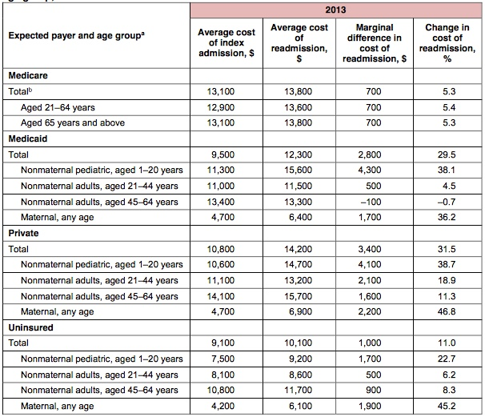
All-Cause Readmissions by Payer and Age, 2009–2013 Marguerite L. Barrett, M.S., Lauren M. Wier, M.P.H., H. Joanna Jiang, Ph.D., and Claudia A. Steiner, M.D., M.P.H.
https://www.hcup-us.ahrq.gov/reports/statbriefs/sb199-Readmissions-Payer-Age.pdf

Slide 7
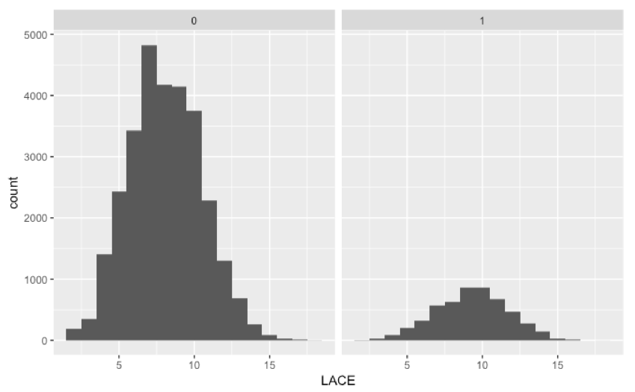
Distribution of LACE scores

Slide 8
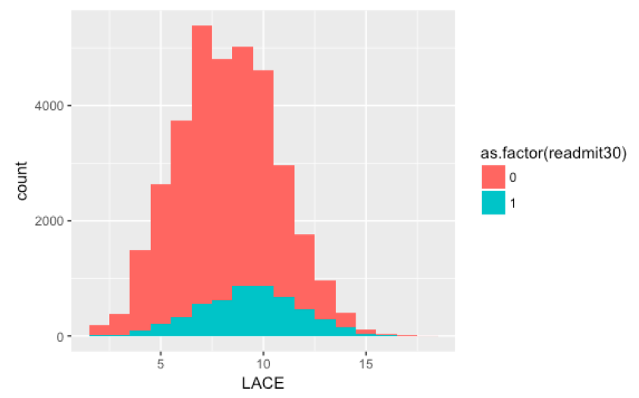
Distribution of LACE scores

Slide 9
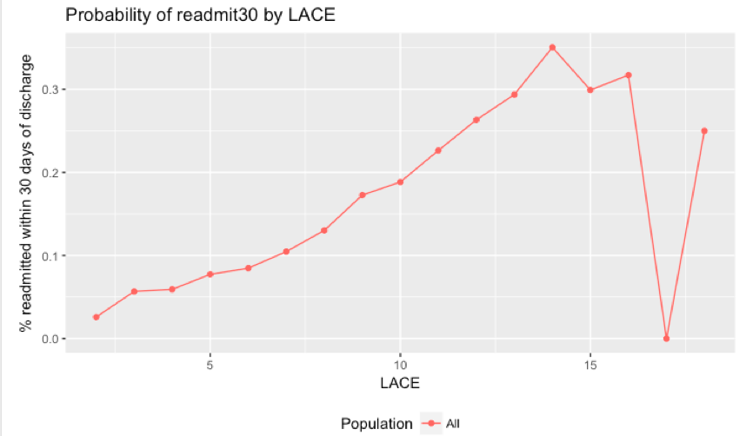
Probability of Readmission by LACE

Slide 10
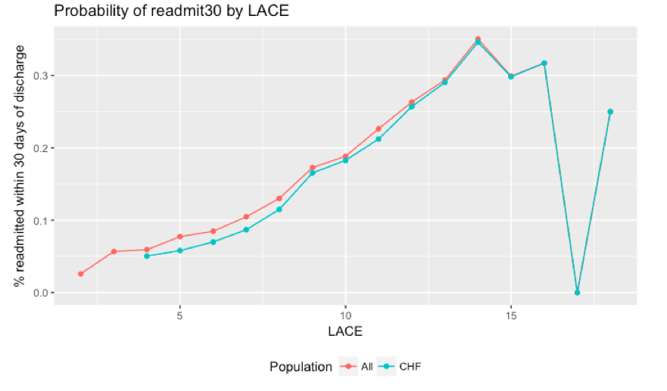
Probability of Readmission by LACE

Slide 11
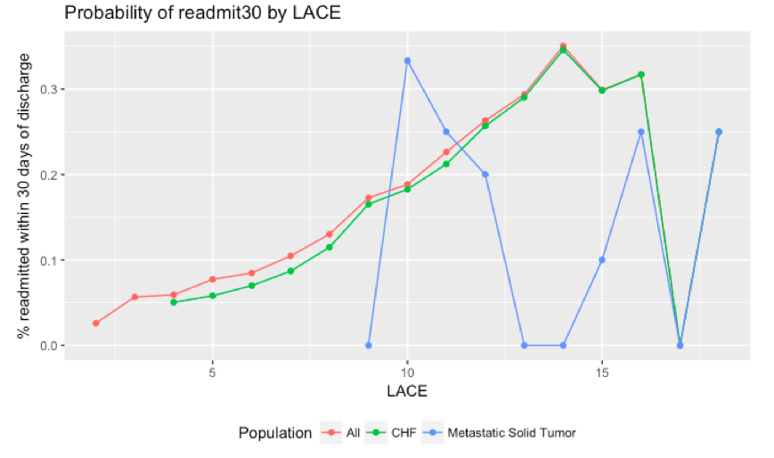
Probability of Readmission by LACE

Slide 12
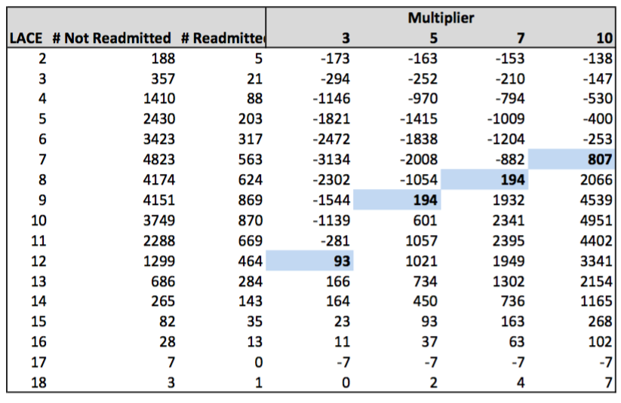
Finding a Breakeven Point (no units)
When is implementing proactive follow-up based on LACE scores cost effective?

Slide 13
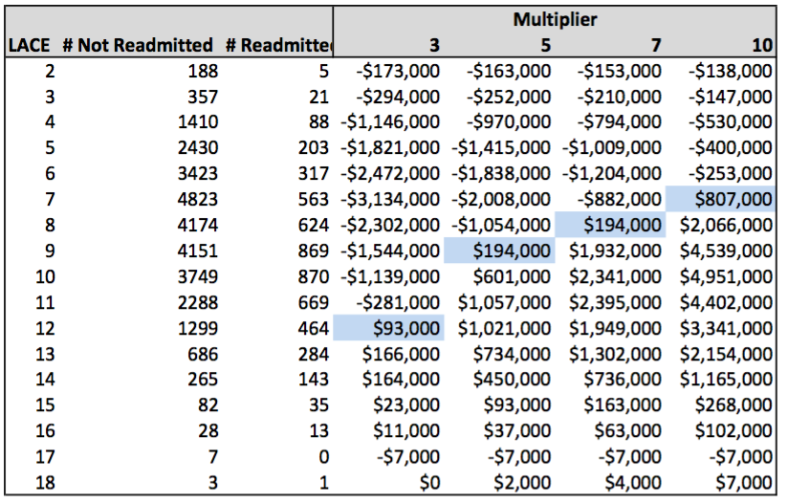
Finding a Breakeven Point (no units)
For example, assuming a $1000 cost per patient of proactive follow-up preventing readmission

Slide 14
Implementation Considerations
Easy to calculate
Easy to understand

Slide 15
Modelling Considerations
Is it better to over-predict the need for attempts to avoid readmission or under-predict?
The cost of missing a readmission is high
The cost of a false positive prediction of readmission in terms of follow-up care outside of admission is relatively small.
Prefer over-prediction to under-prediction

Slide 16
Predicting Readmission of CHF Patients
C (Co-morbidity) Score Only
Total Lace Score
Predicted
 | N | Y
N | 4587 | 1259
Y | 824 | 236
Total Accuracy: 69.8%
True Negatives: 78.5%
True Positives : 22.2%
Expected
Predicted
 | N | Y
N | 3358 | 2516
Y | 357 | 675
Expected
Total Accuracy: 58.4%
True Negatives: 57.2%
True Positives: 64.5%
Notes:
Example results of both the total LACE score and individual LACE components for CHF

Slide 17
Conclusions / Recommendations
●Based on the results for CHF, Dementia, and Metastatic Solid Tumors, we recommend using a predictive model as an accurate and efficient method of interpreting the total LACE score to predict 30-day readmissions.
●Going forward: Use these predictions to further study the cost benefits of preventative care for those identified as 30-day readmits is recommended to fully judge the success of this project.

